Slide 1
Department Of Computer Science
GUIDANCE OF :
Prof. A. MARY ASHA M.SC., M.Phil.,
Asst.Professor,
Department of Computer Science,
Loyola College, Vetavalam
By
Parasuraman D [23021U18028] [21UCS18]

Slide 2

ENFORCEMENT DIRECTORATE

Slide 3
ABSTRACT
The Directorate of Enforcement (Ed) Is A Domestic Law Enforcement Agency And Economic Intelligence Agency Responsible For Enforcing Economic Laws And Fighting Economic Crime In India. It Is Part of The Department of Revenue, Ministry of Finance, Government Of India.
The Origin Of The Ed Goes Back To 1 May 1956, When An "Enforcement Unit" Was Formed, Within The Department Of Economic Affairs, For Handling Exchange Control Laws Violations Under The Foreign Exchange Regulation Act, 1947.
In 1957, The Unit Was Renamed as The Enforcement Directorate. Main Laws in Ed Foreign Exchange Management Act, 1999 (FEMA), Prevention of Money Laundering Act, 2002 (PMLA), Fugitive Economic Offenders Act, 2018 (FEOA), Conservation Of Foreign Exchange And Prevention Of Smuggling Activities Act, 1974 (COFEPOSA).
The ENFORCEMENT DEPARTMENT has sky-high powers

Slide 4
ABSTRACT ~ CON
Key functionalities of the ED-WEB system include user authentication, transaction monitoring, complaint management, and credential management. Through these features, the system enables seamless collaboration between enforcement officers, regulatory authorities, and financial institutions to identify and mitigate risks associated with illicit financial activities.
The ED-WEB system caters to the diverse needs of enforcement officers, regulatory authorities, and financial institutions, providing them with the tools and resources required to identify, investigate, and prosecute illicit financial activities effectively. By centralizing user transactions, monitoring suspicious activities, and facilitating complaint management, the system empowers enforcement officers to stay ahead of sophisticated financial criminals.

Slide 5
SOFTWARE REQUIREMENTS
Operating System : Windows 8, 10, 11 ( Or ) Mac ( Or ) Linux
Web Browser : Google Chrome, Mozilla Firefox, Internet Explorer
Drivers : Java Runtime Environnement, Node.js
IDE : IntelliJ Idea, Visual Studio Code
Java, Angular, MySQL

Slide 6
HARDWARE REQUIREMENTS
Processors : Intel (I5, I7, I9) , AMD
Memory (Ram) : 4GB, 8GB, 16GB
Storage : 256 Gb SSD For Faster Or HDD
Network Interface : Ethernet Or Wi-Fi

Slide 7
EXISTING SYSTEM
After Getting Information Through the Informer, They Took Action So That Some Money Transaction Are Not Know, Because the Informer Does Not Know The Secret Transaction
So, ED Miss Illegal Transaction, also chance to escape that accused and evidence, and it need more time to take action against the accused or difficult to collect the evidence against accused. Officer know the transaction after a days, a weeks, a month, or a year.

Slide 8
PROPOSED SYSTEM
The Proposed Ed Website Can Monitor or Record Every Transaction. If the Transaction Have Any Illegal Money, Ed Take Action Against the Person which mean sender and receiver.
The Web Does Not Miss Any Illegal Transaction So the Accused Does Not Escape, Also It Report the Officer Profile at The Time Of Transaction, So It Does Not Take The More Time To Know The Info About Transaction

Slide 9
MODULES
Ed User
Ed Officer
Ed Admin
Login
Sign Up
View Profile
View Bank Info
Make Payment to other
View History of Transaction
View Complaints if Transaction is Illegal
Login
Manage User & Officer
Manage User & Officer Credentials
Monitor User Payment
Raise Complaint if is Illegal
Revoke Complaint if User Prove the Transaction is legal
Login
Manage All User [ User, Officer, Admin, Credentials, Roles ]

Slide 10
MODULES
Ed Payment
Ed Credential
Make Payment
View All Payment
View Particular payment
View Payment info
View User Credential
Modify User Credential

Slide 11
UML DIAGRAM

Slide 12
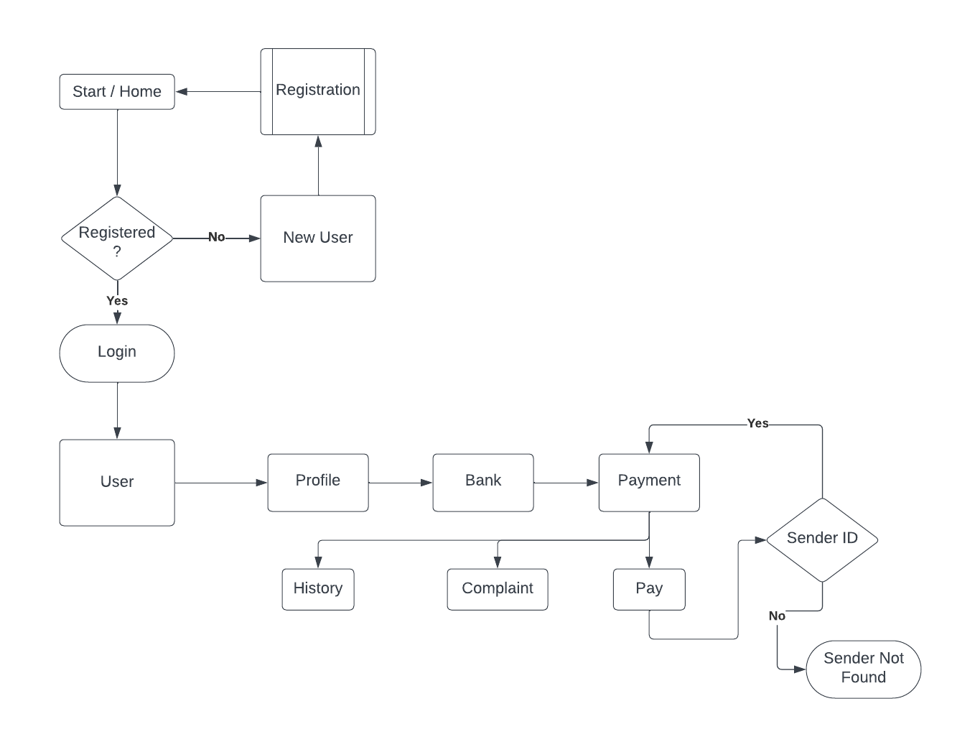
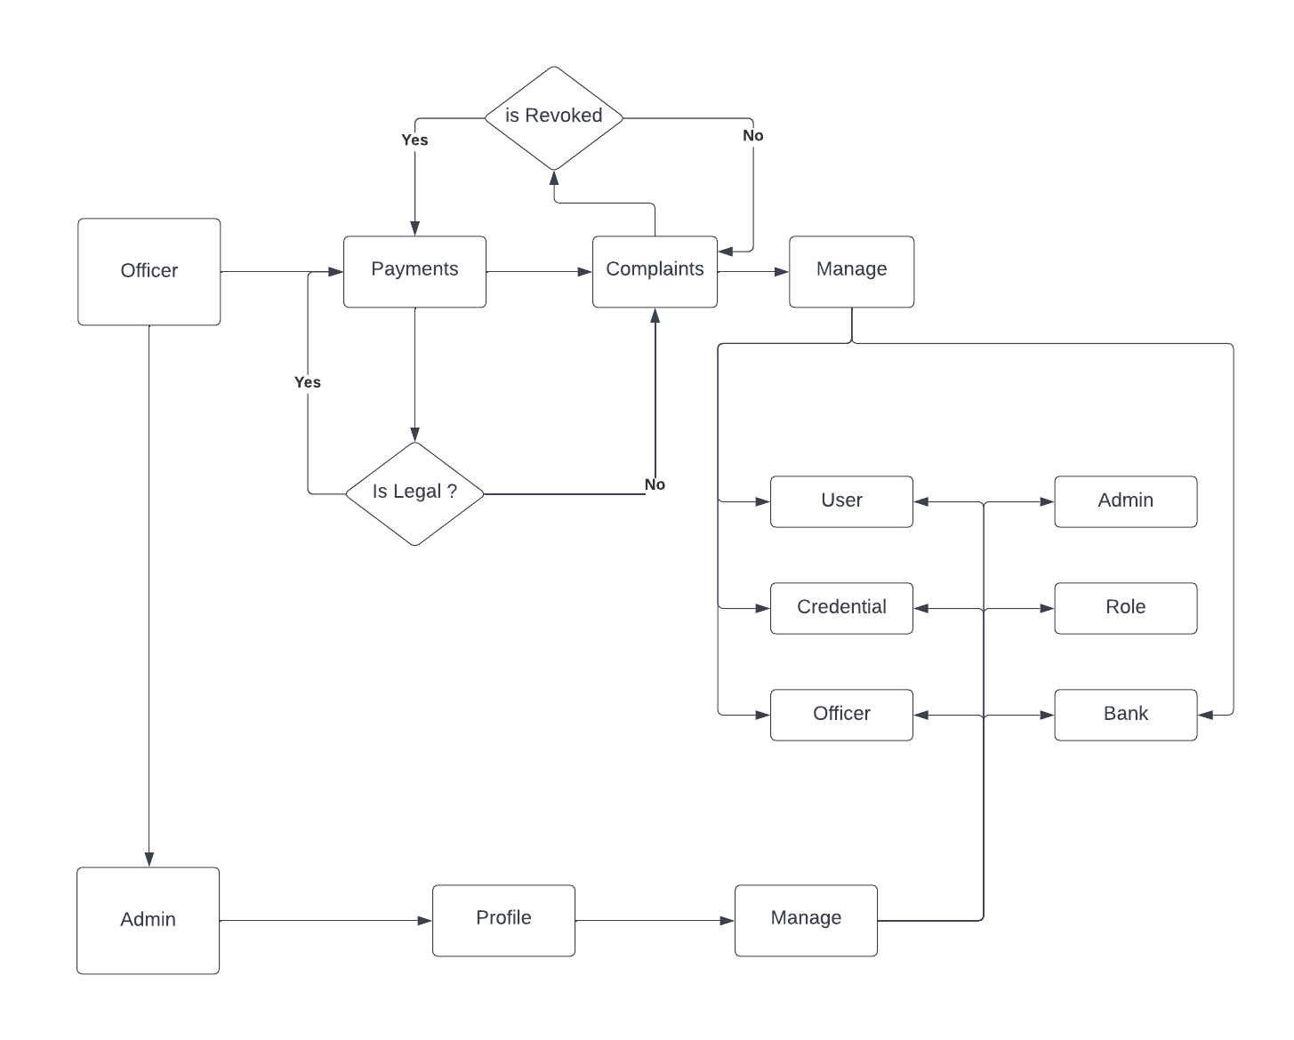
SYSTEM FLOW DIAGRAM

Slide 13
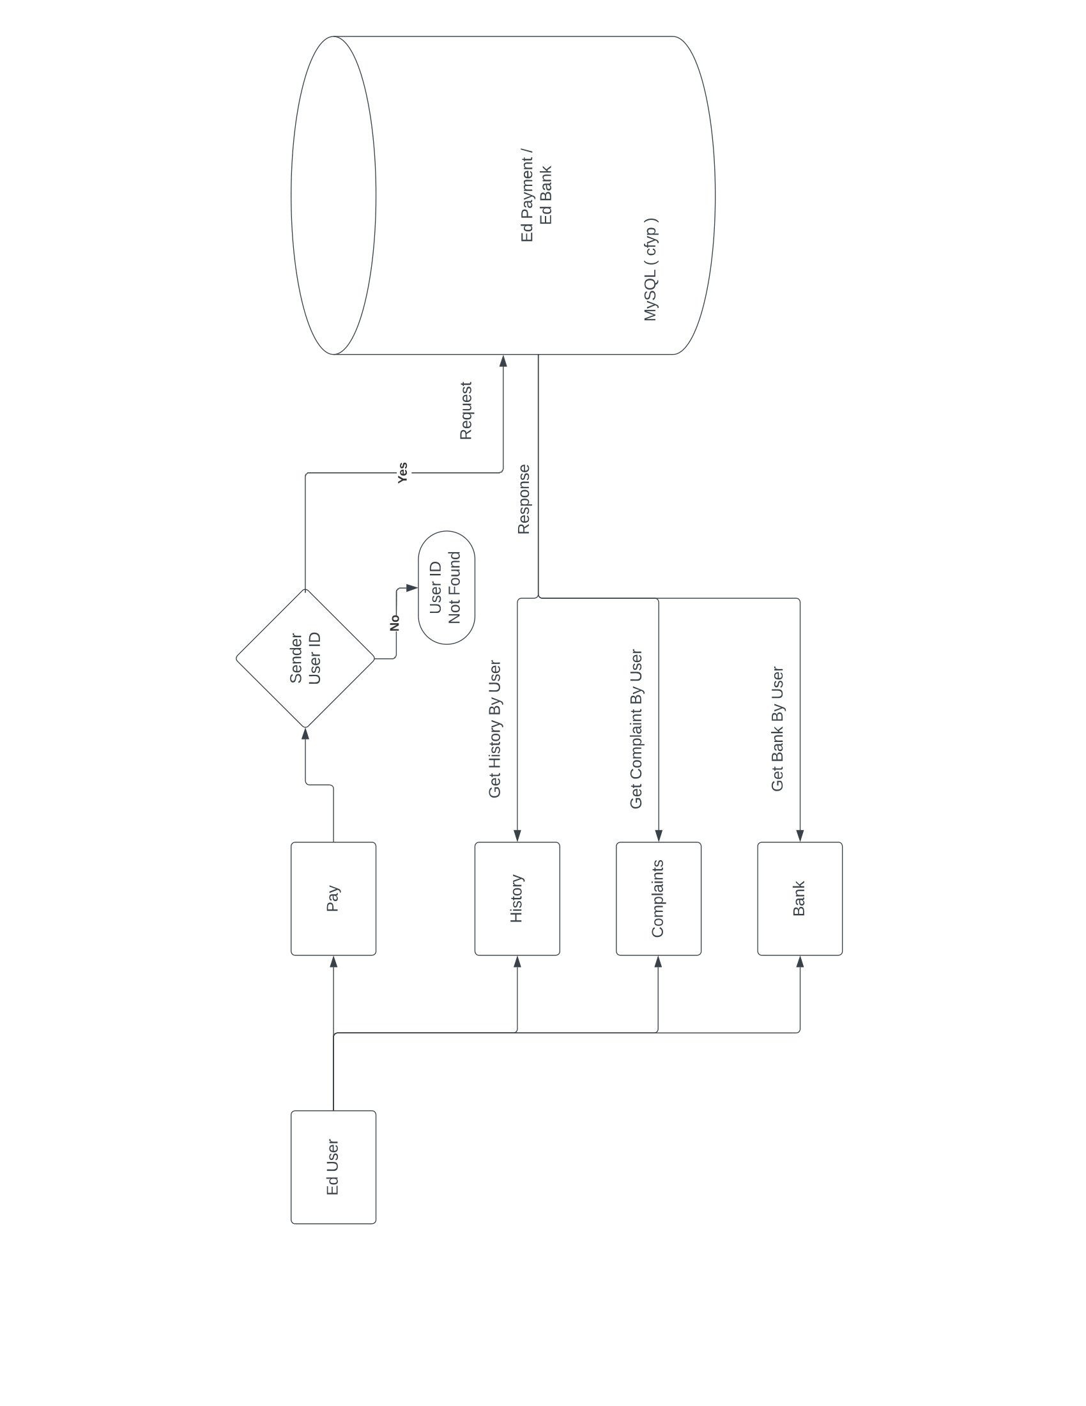
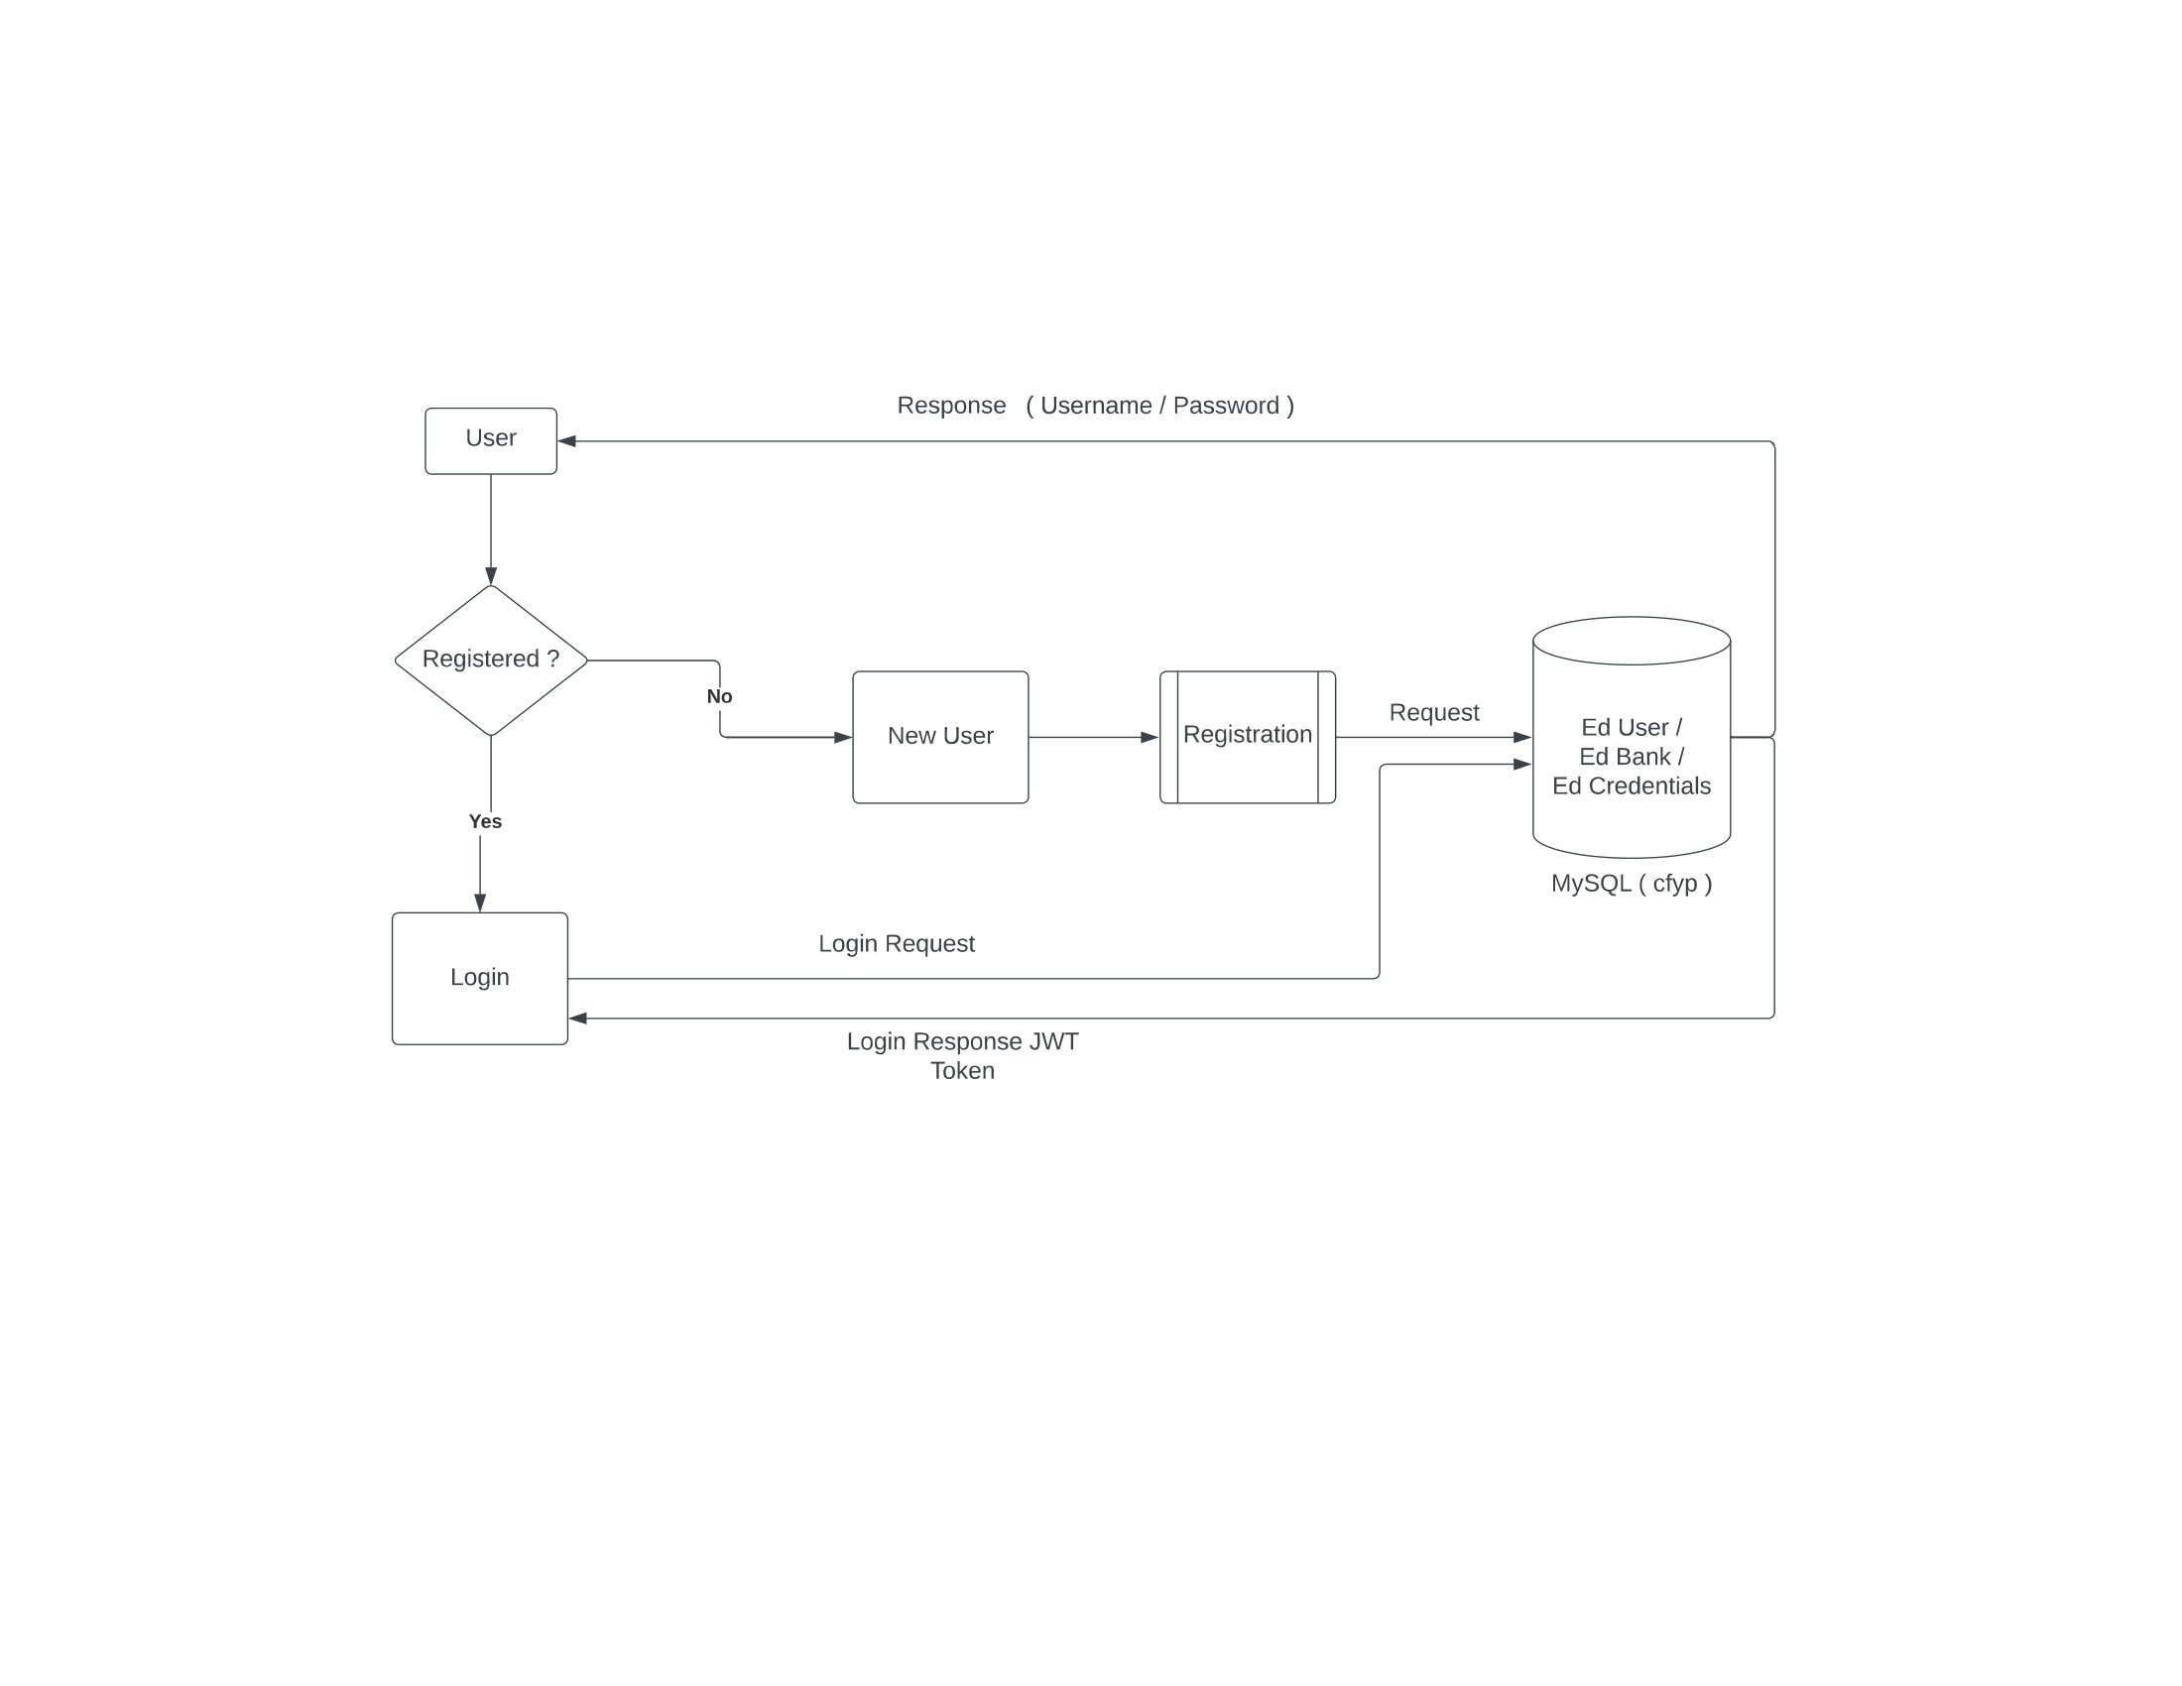
DATA FLOW DIAGRAM

Slide 14
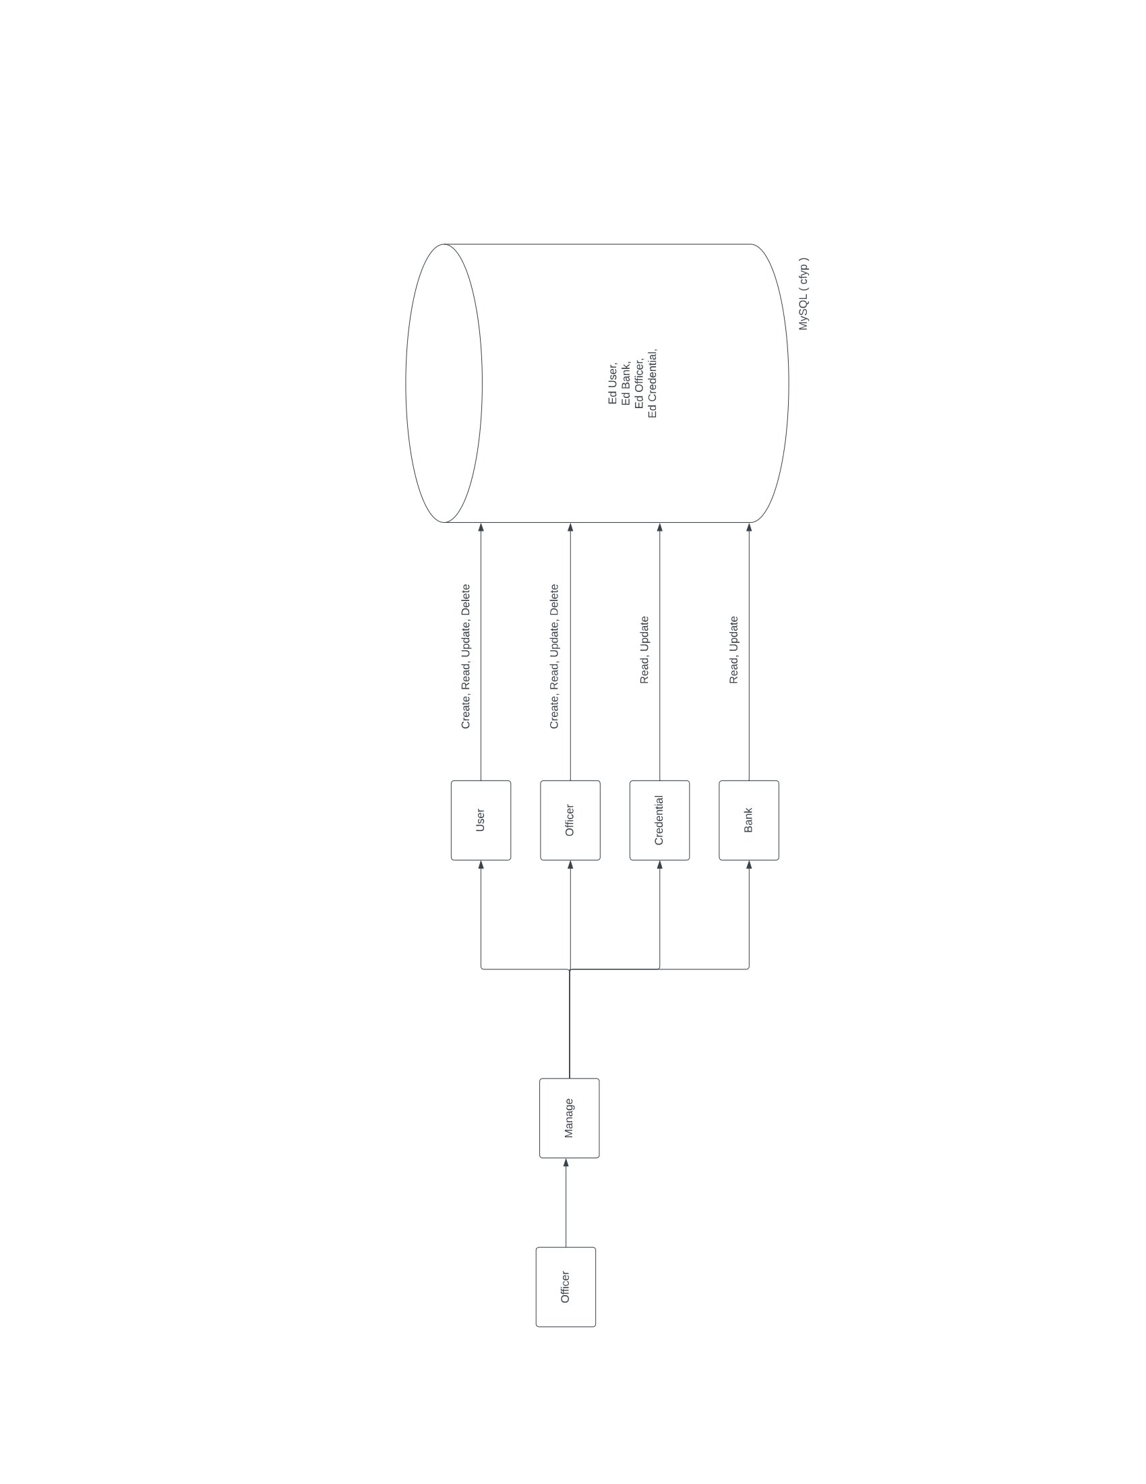
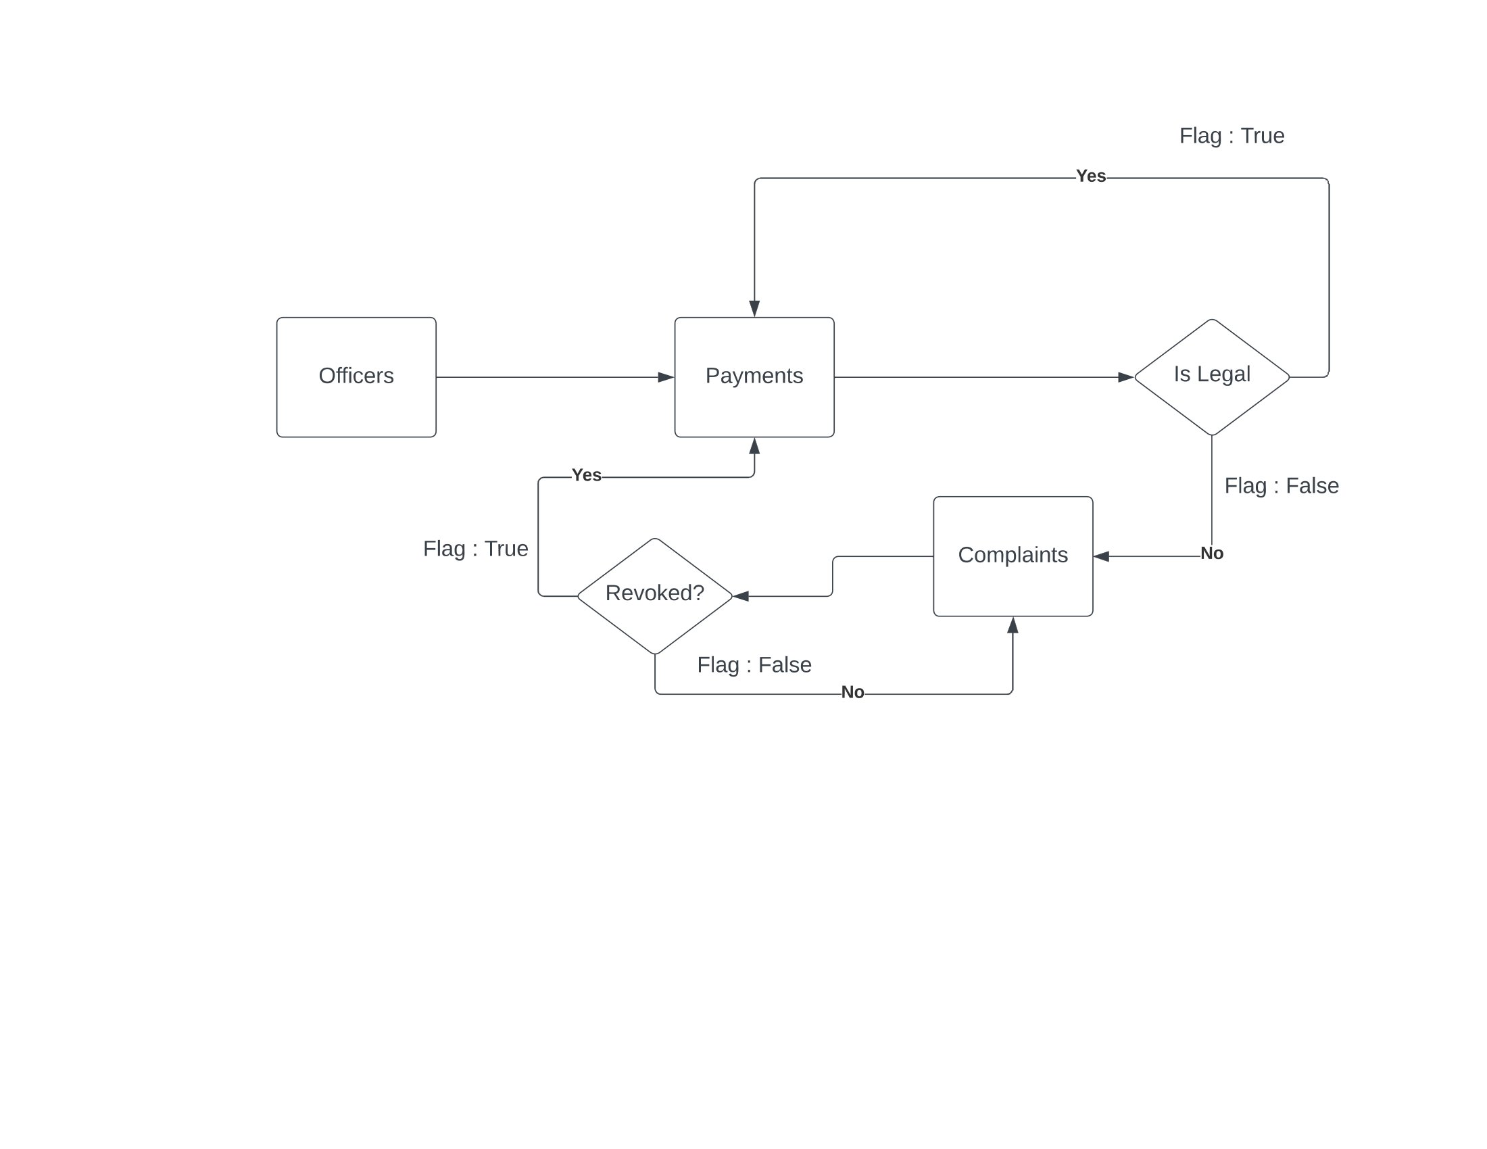
DATA FLOW DIAGRAM ~ CON

Slide 15
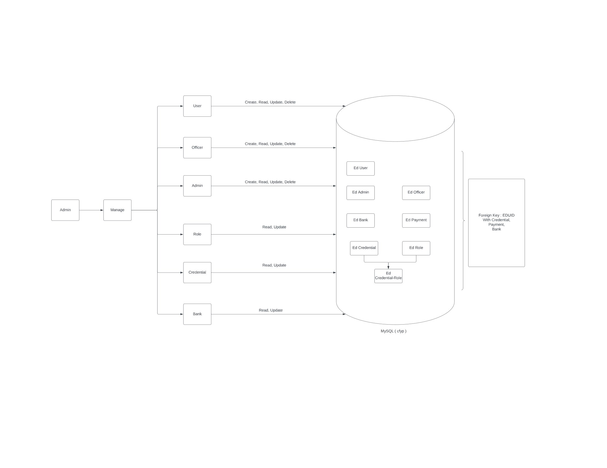
DATA FLOW DIAGRAM ~ CON

Slide 16
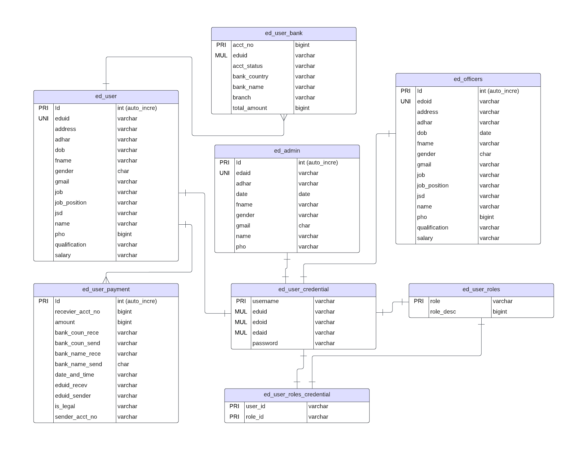
ENTITY RELATIONSHIP DIAGRAM

Slide 17
SCREENSHOTS WITH VALID DATA [ INPUT / OUTPUT ]

Slide 18
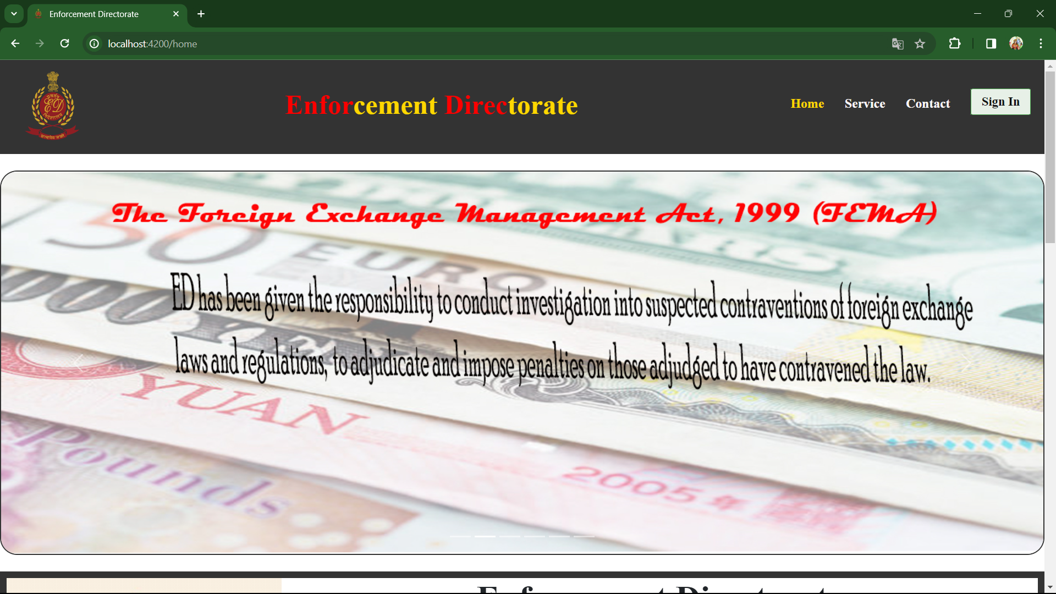

Slide 19
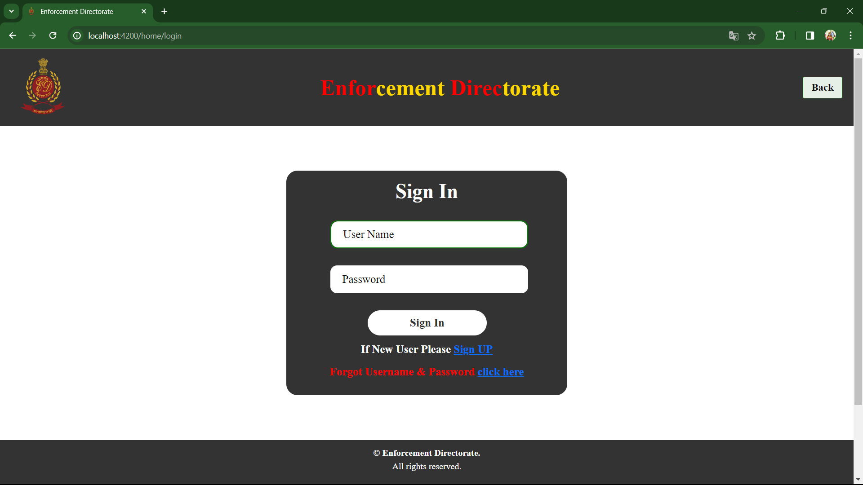

Slide 20
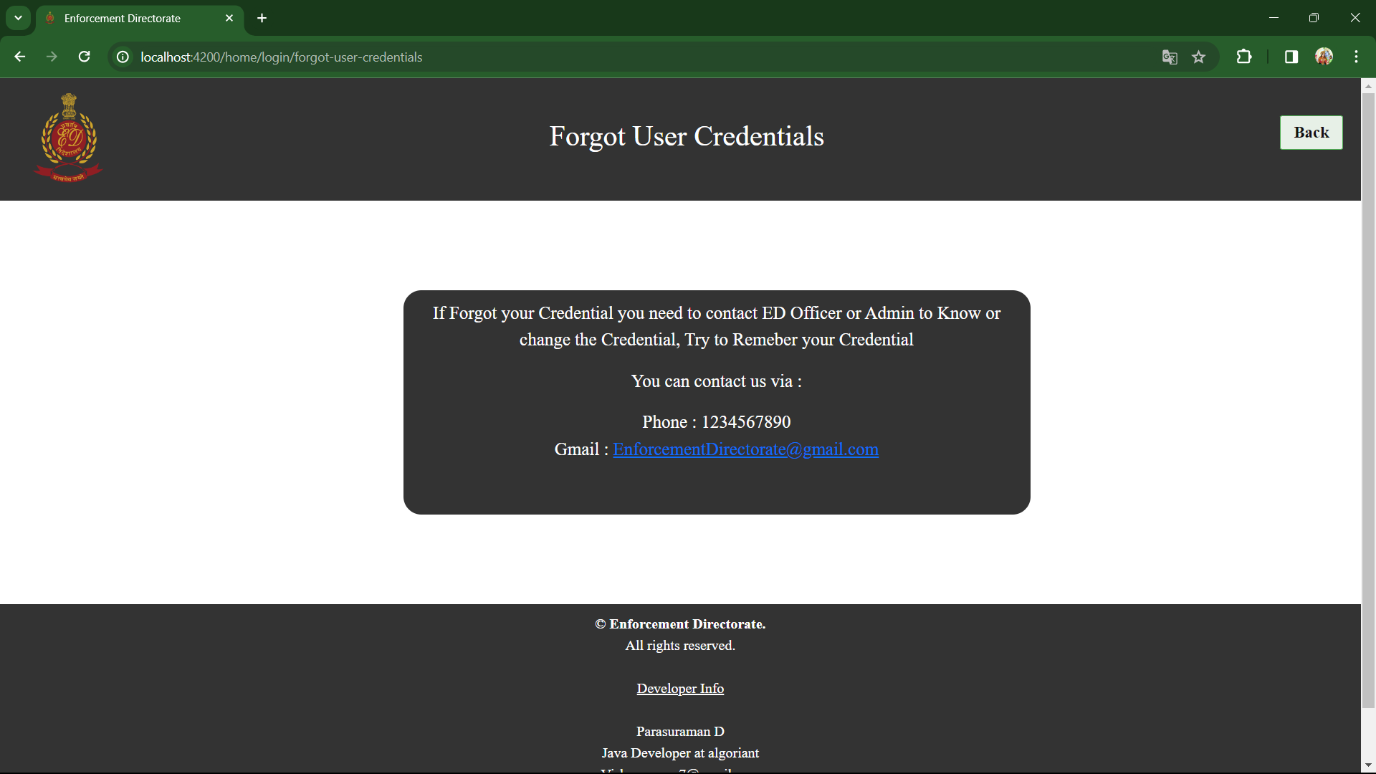

Slide 21
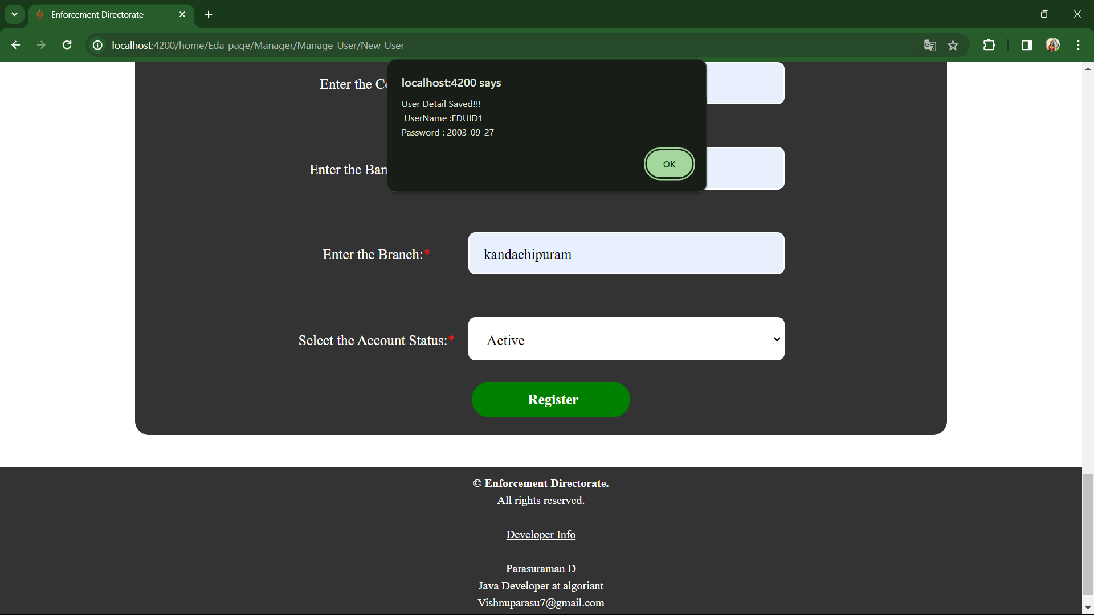

Slide 22
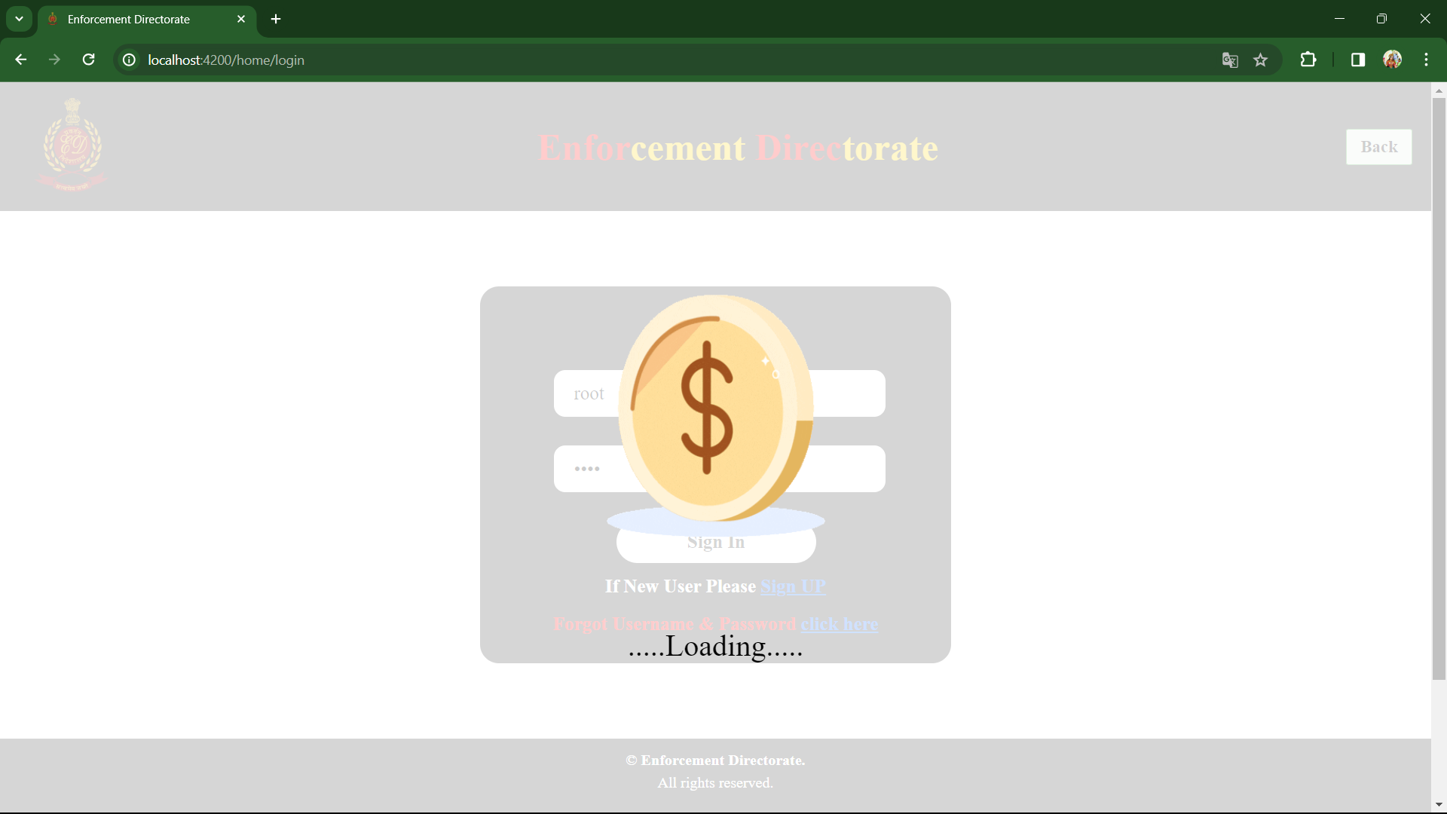

Slide 23
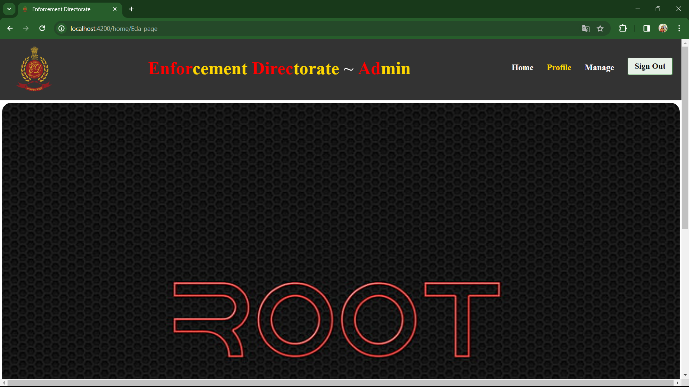

Slide 24
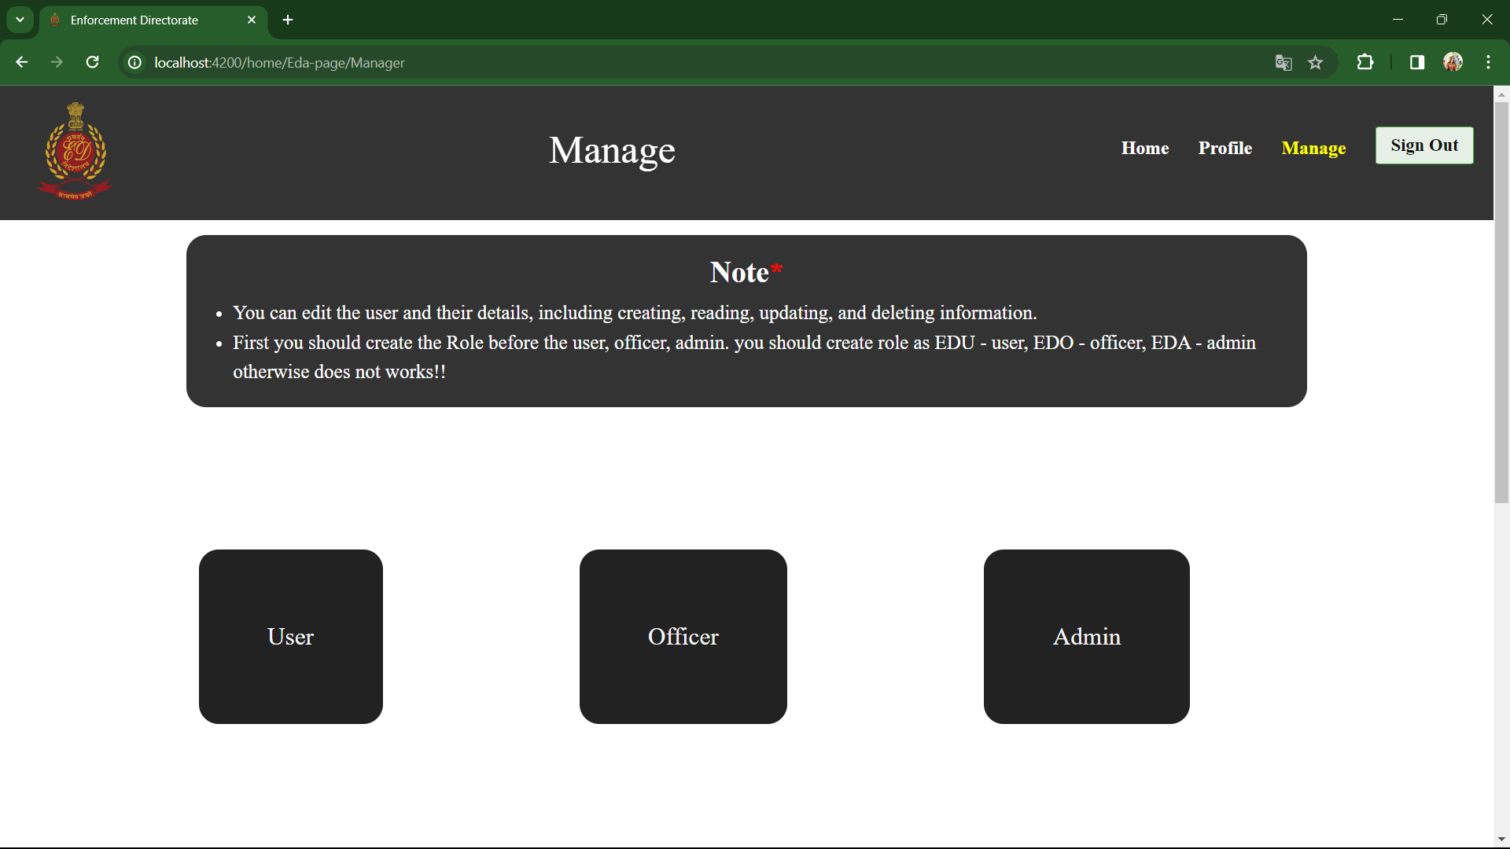

Slide 25
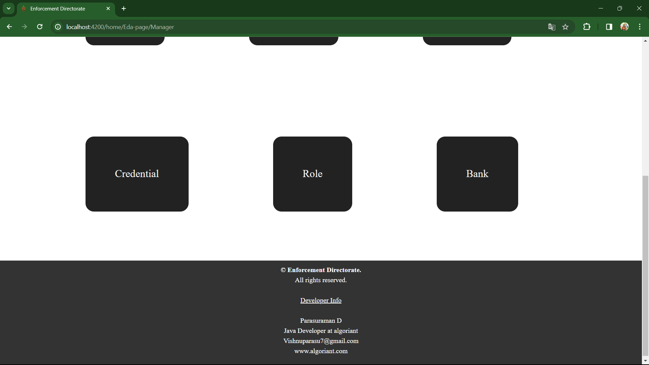

Slide 26
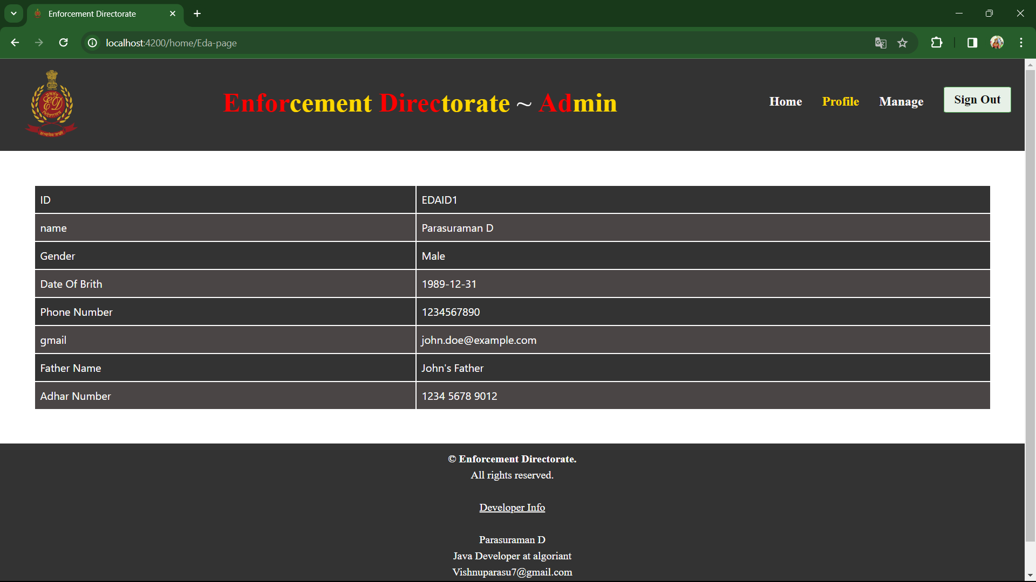

Slide 27
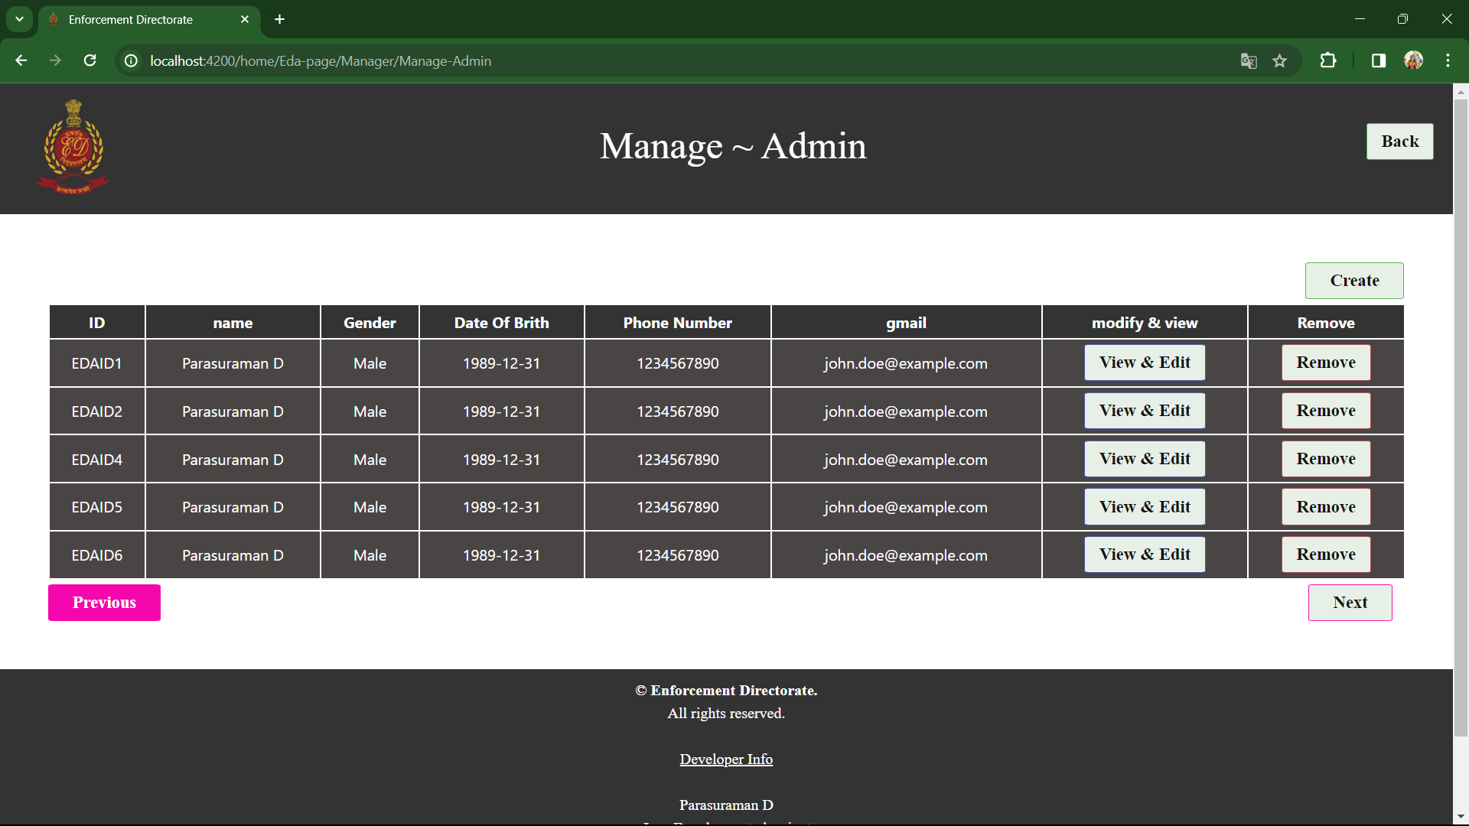

Slide 28
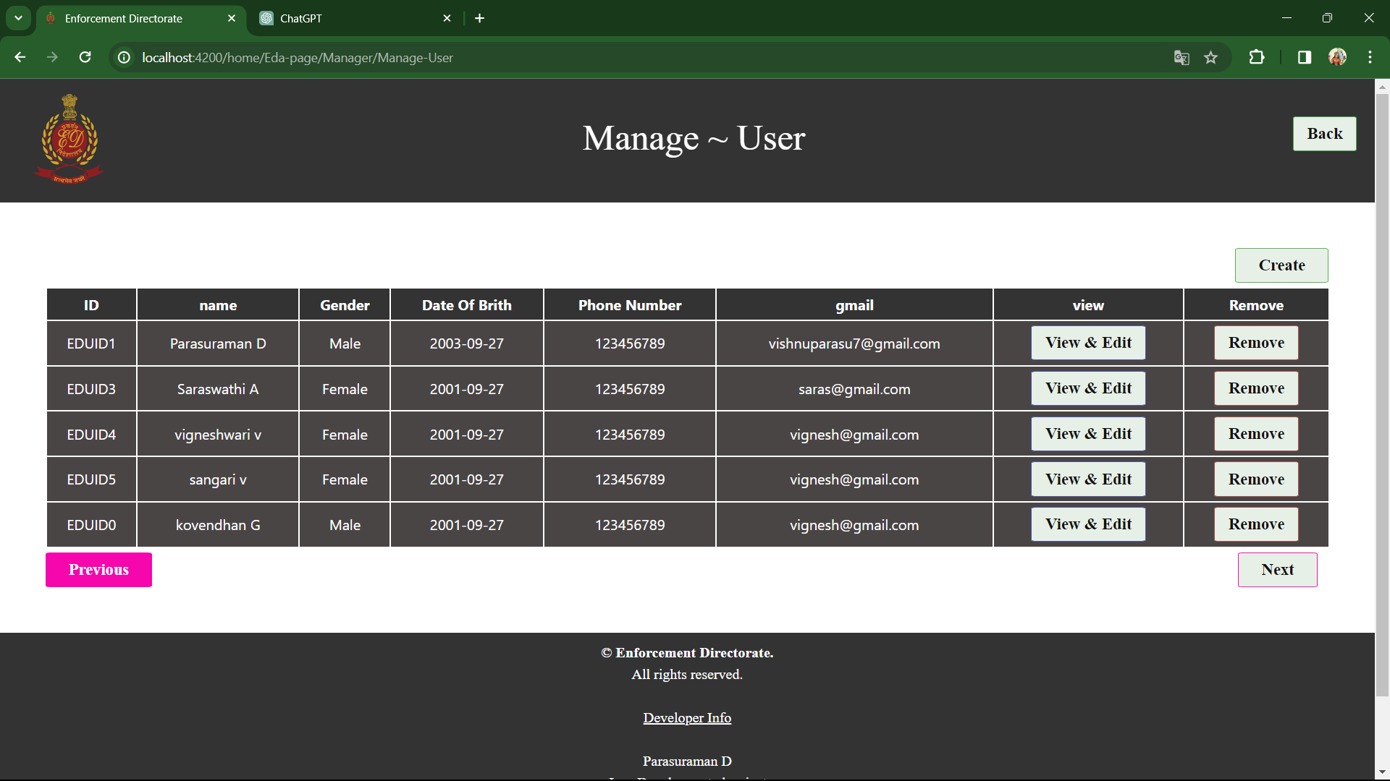

Slide 29


Slide 30
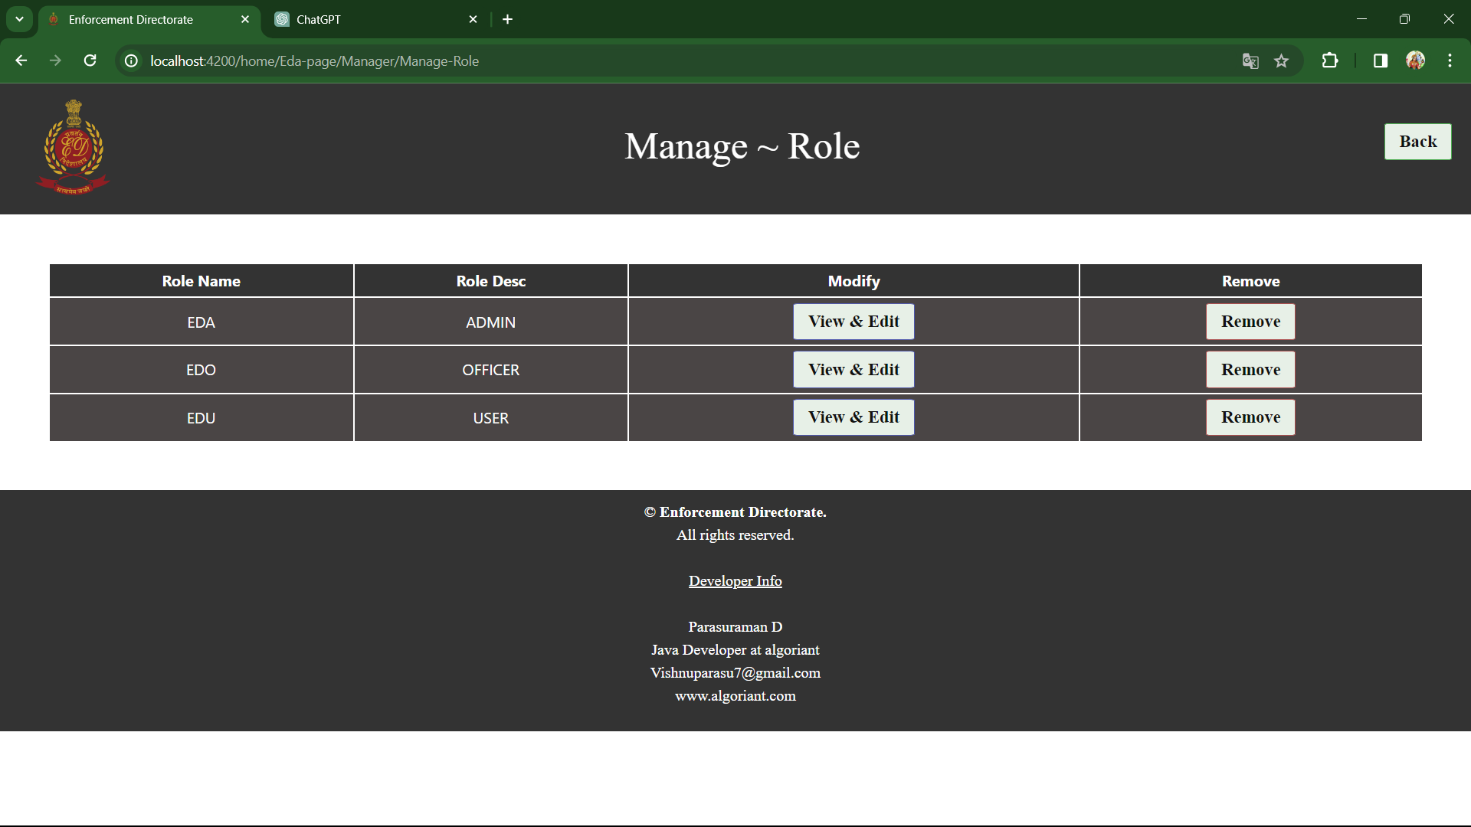

Slide 31
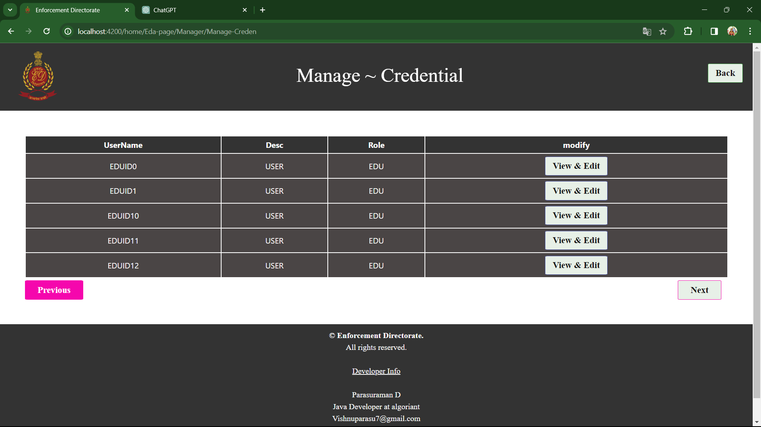

Slide 32
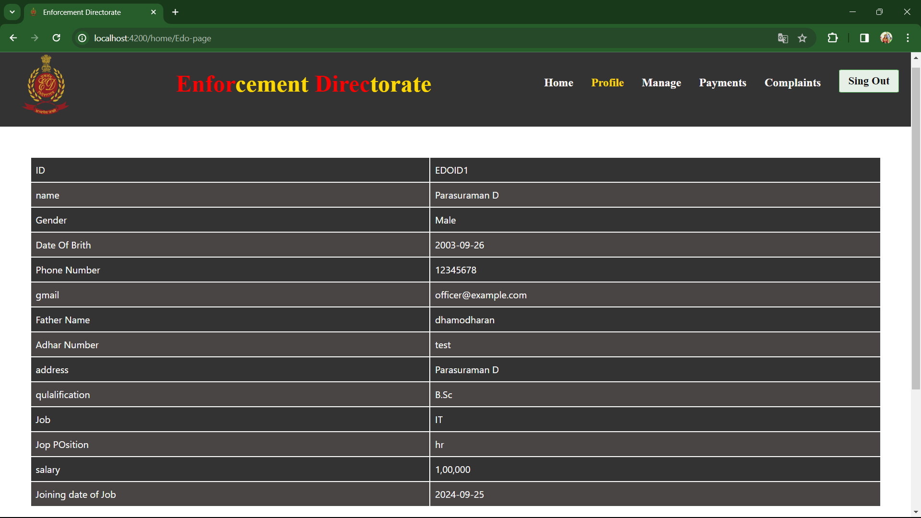

Slide 33
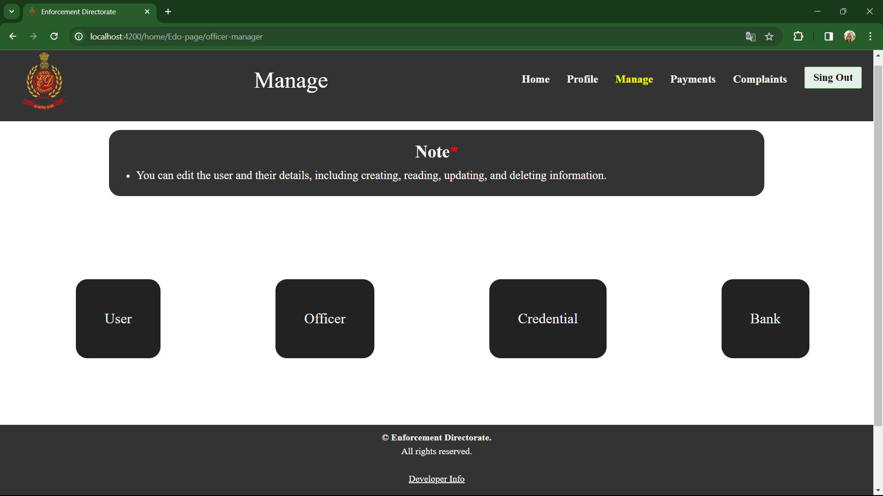

Slide 34
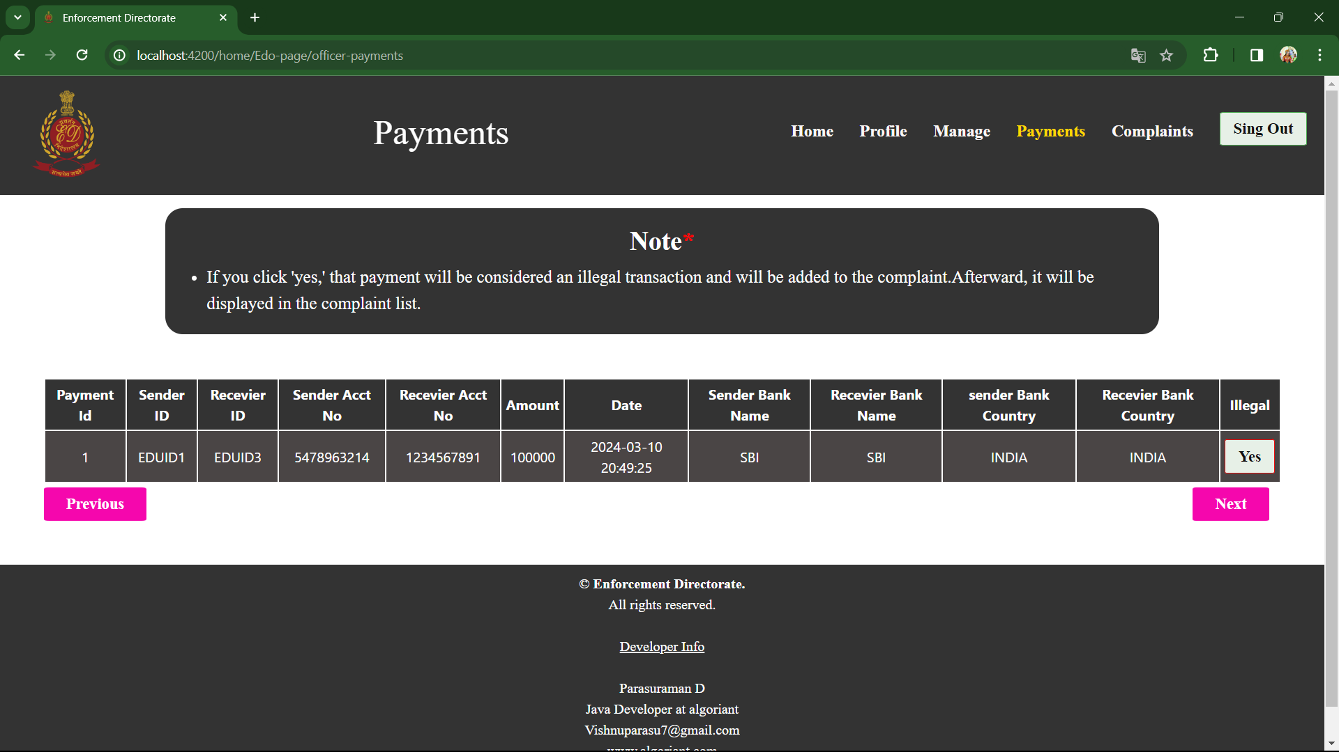

Slide 35
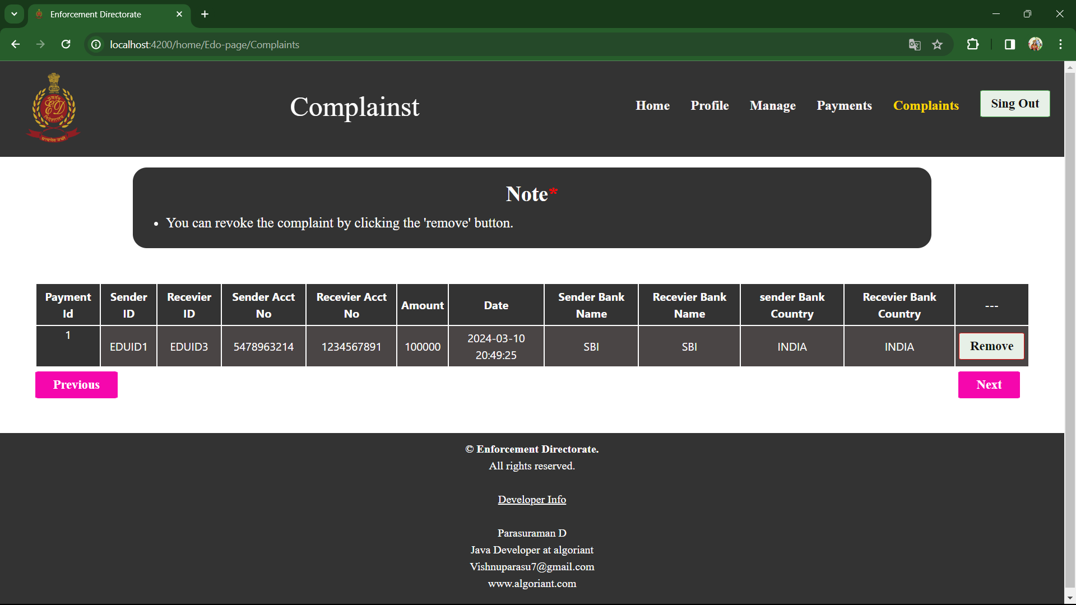

Slide 36
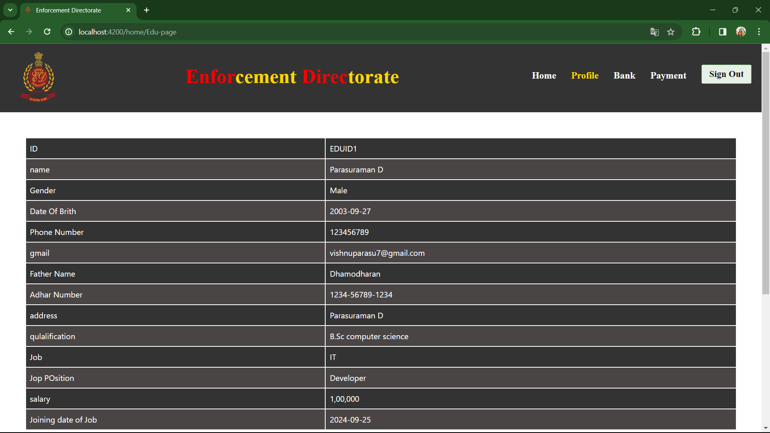

Slide 37
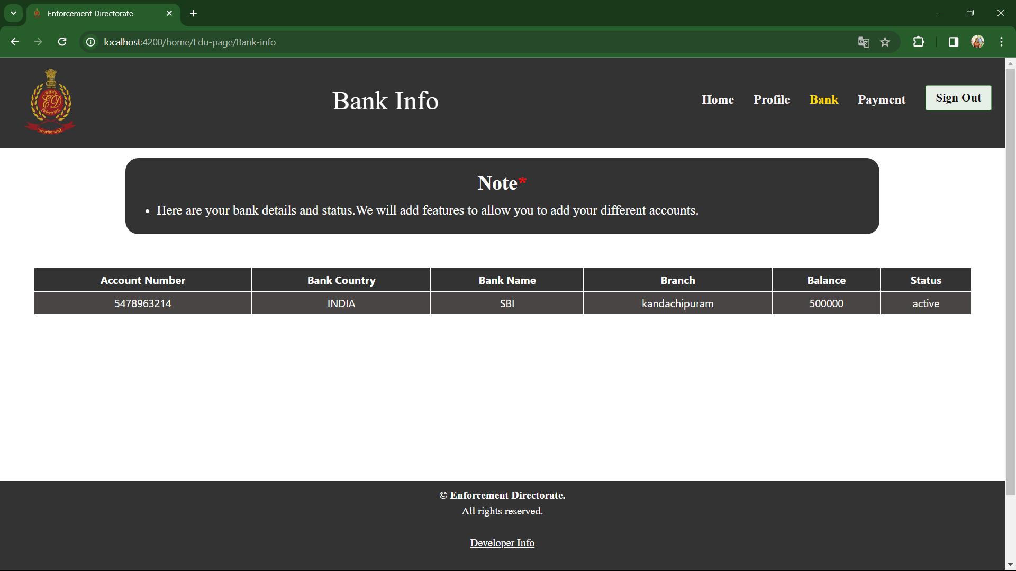

Slide 38
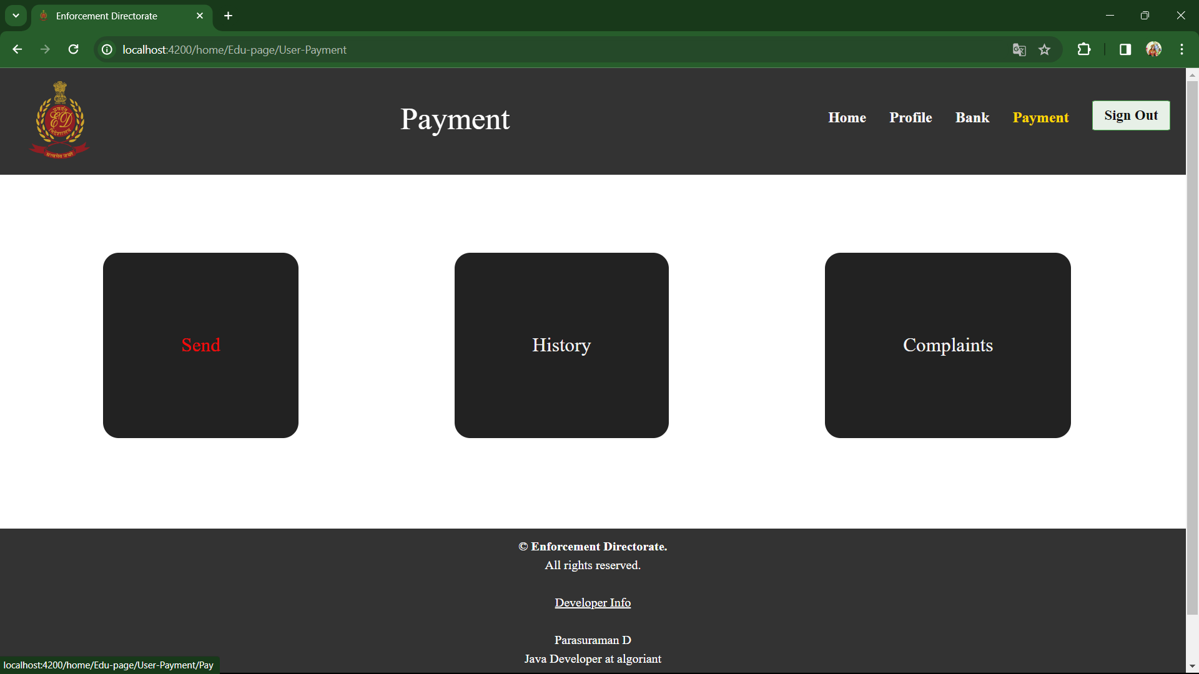

Slide 39
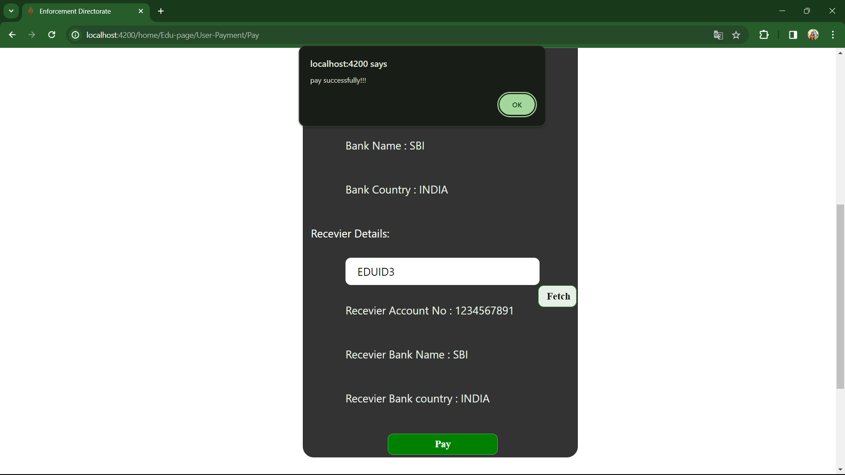

Slide 40
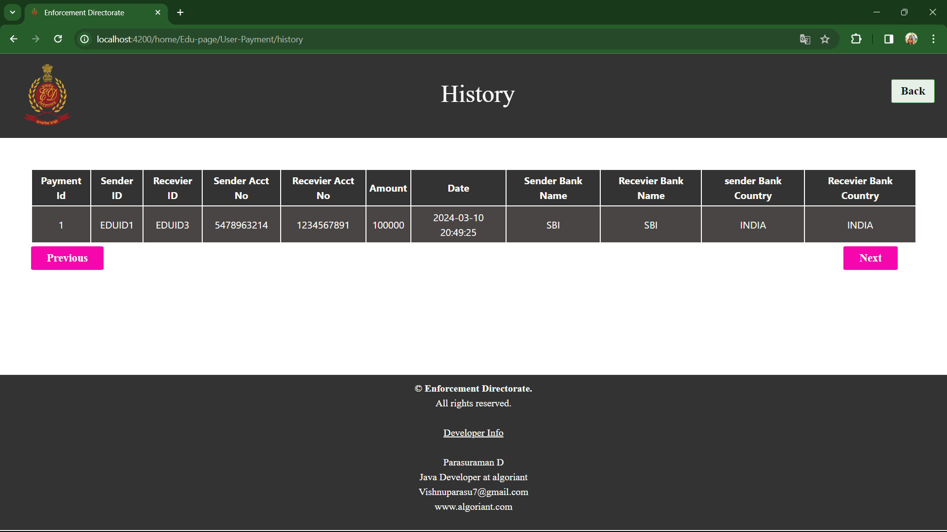

Slide 41
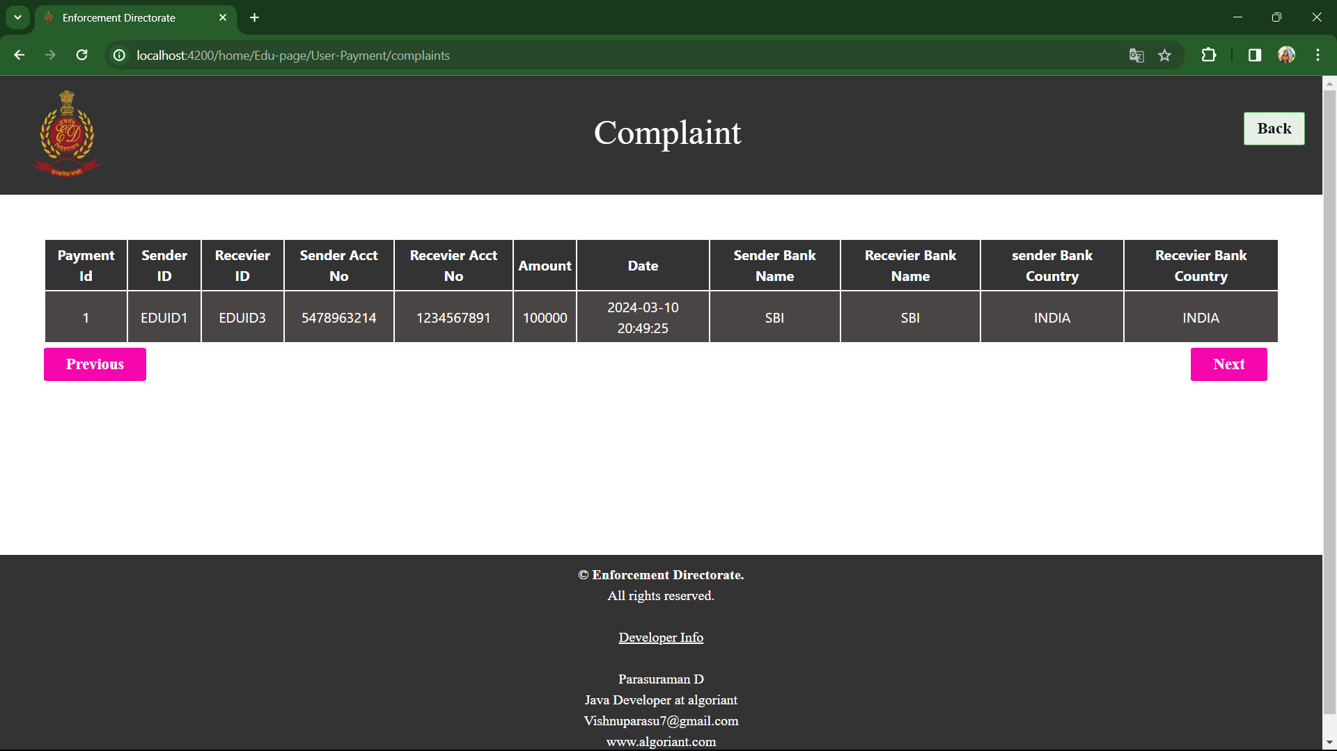

Slide 42
FINAL WORDS

Slide 43
CONCLUSION
The project's comprehensive approach encompasses advanced data analytics, robust regulatory frameworks, and stringent enforcement measures, enabling us to detect and deter attempts to generate, conceal, or launder illicit funds. By leveraging technology and intelligence-sharing mechanisms, we have strengthened our ability to track financial transactions, expose hidden assets, and dismantle criminal networks involved in illicit financial activities
Looking ahead, we recognize that the fight against black money and money laundering is an ongoing battle that requires vigilance, adaptability, and international cooperation. As such, we remain steadfast in our commitment to strengthening regulatory frameworks, enhancing cross-border cooperation, and leveraging emerging technologies to stay ahead of sophisticated financial criminals.

Slide 44

By
Parasuraman D [23021U18028] [21UCS18]
GUIDANCE OF
Prof. A. Mary Asha M.Sc., M.Phil.,

